Slide 1
IDA CASE STUDY 4
Asset Management
Batch 2
Sidharth Bansal
Pagidala Saketh Reddy
Atul Pardhi
Gowree Manohar
Utkarsh Dwivedi

Slide 2
PROBLEM STATEMENT
In the dynamic landscape of the global upstream oil and gas industry, understanding the historical
trends and future projections is essential for informed decision-making and strategic planning. Despite
the vast amount of data available through UCube Global, there remains a need to harness its potential
to address critical challenges and opportunities within the sector. This case study aims to delve into
the complexities of the industry by leveraging the UCube database to analyze production, economics,
costs, revenues, and valuation of over 80,000 assets across more than 3,500 companies. The goal is to
uncover insights that can drive macro analyses, inform market strategies, aid in company valuation,
facilitate business development, and shed light on the oil service industry's market dynamics. By
conducting a thorough analysis of the historical and projected E&P activities from 1900 to 2100, this
study seeks to provide actionable recommendations and strategic direction to stakeholders aiming to
navigate the ever-evolving landscape of the oil and gas sector

Slide 3
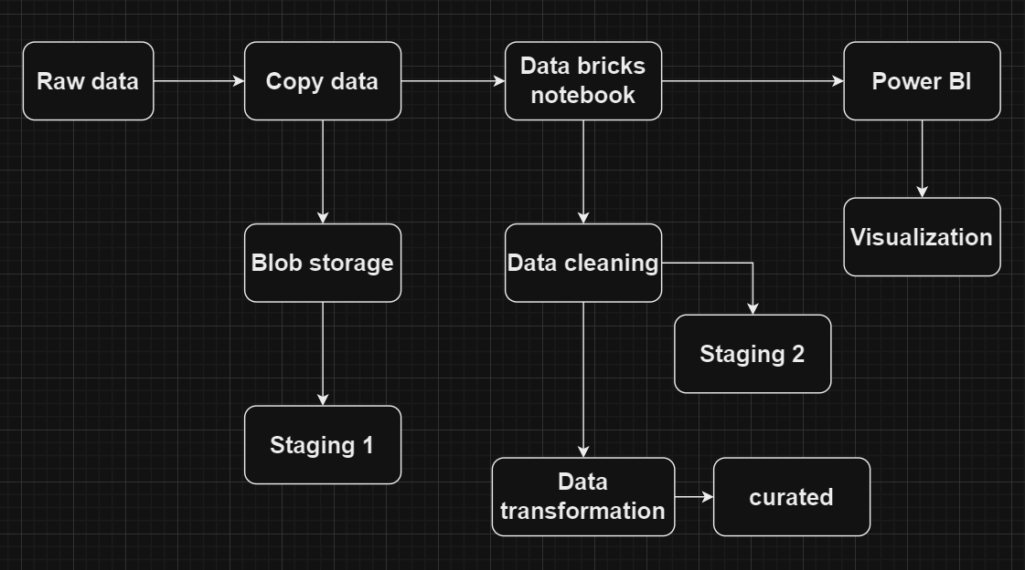
Data Flow Diagram in ADF

Slide 4
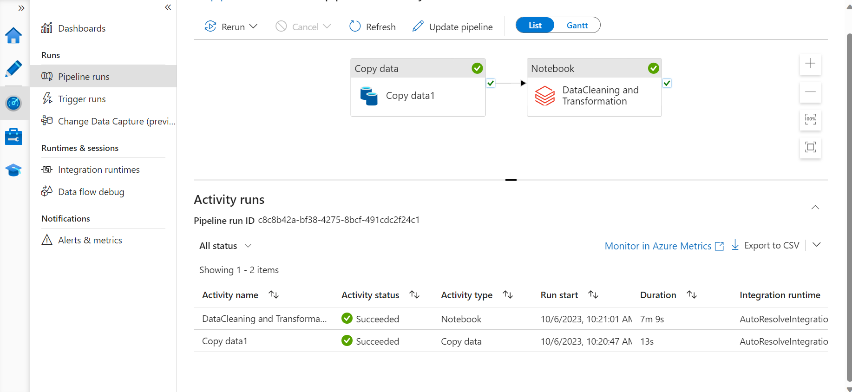
Pipeline Execution

Slide 5
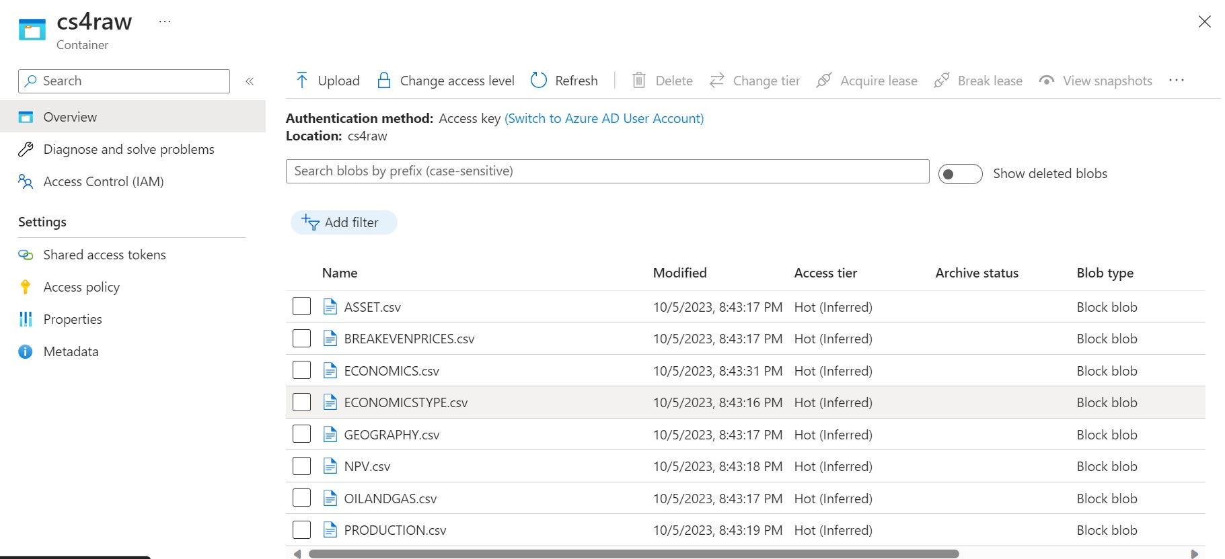
Raw

Slide 6
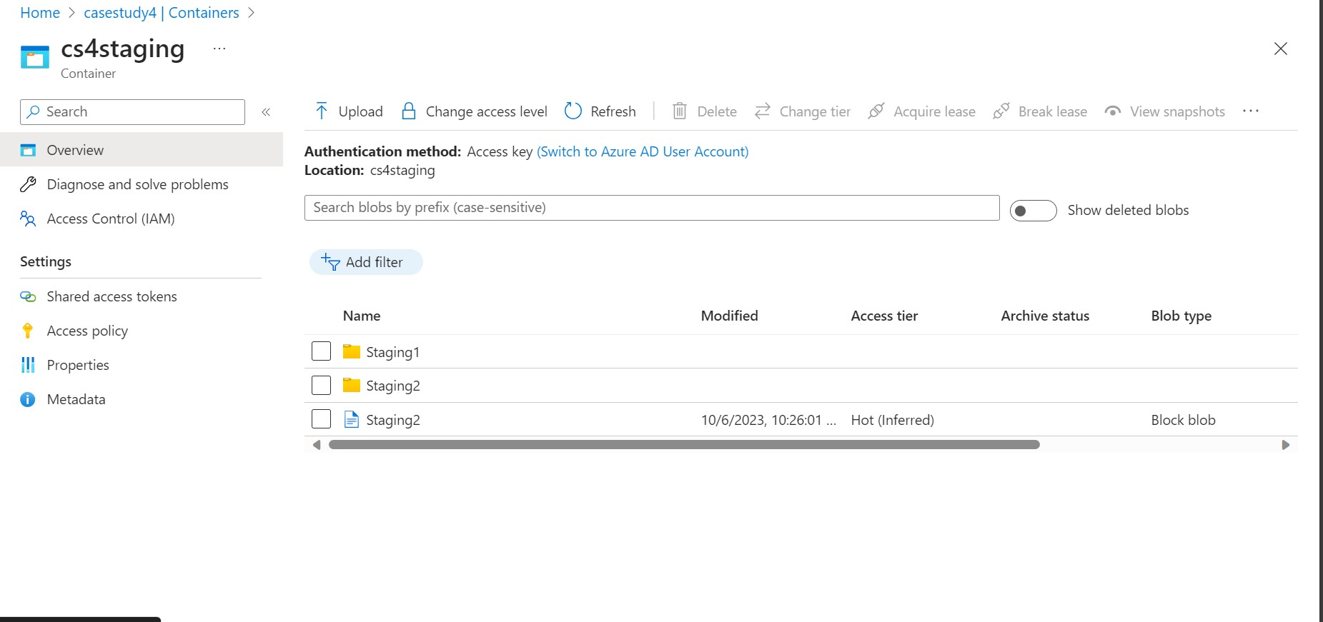
Staging

Slide 7
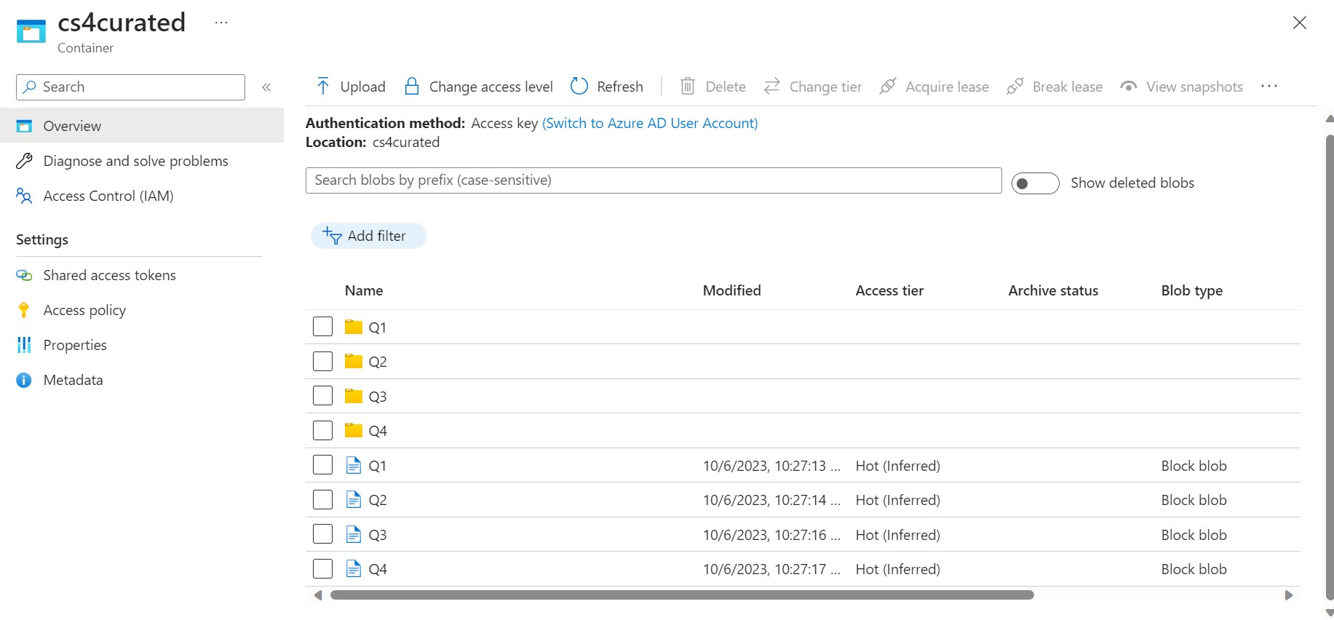
Curated

Slide 8
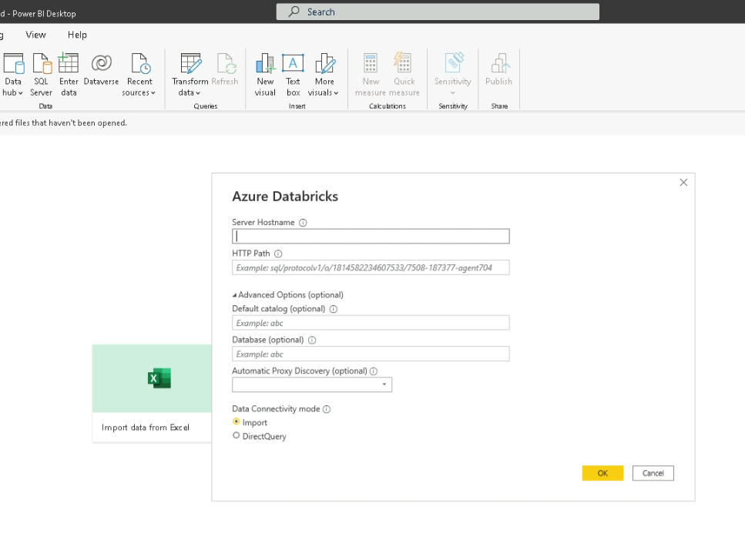
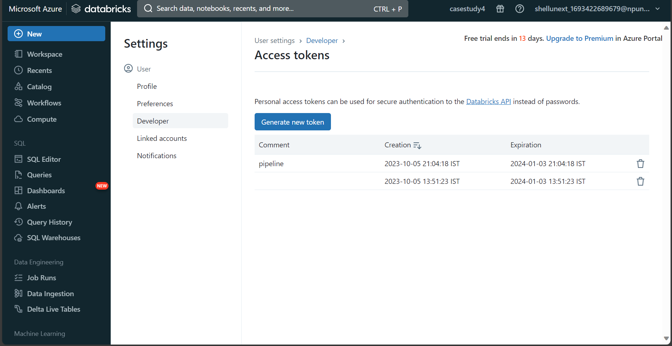
Connection from databricks to BI

Slide 9
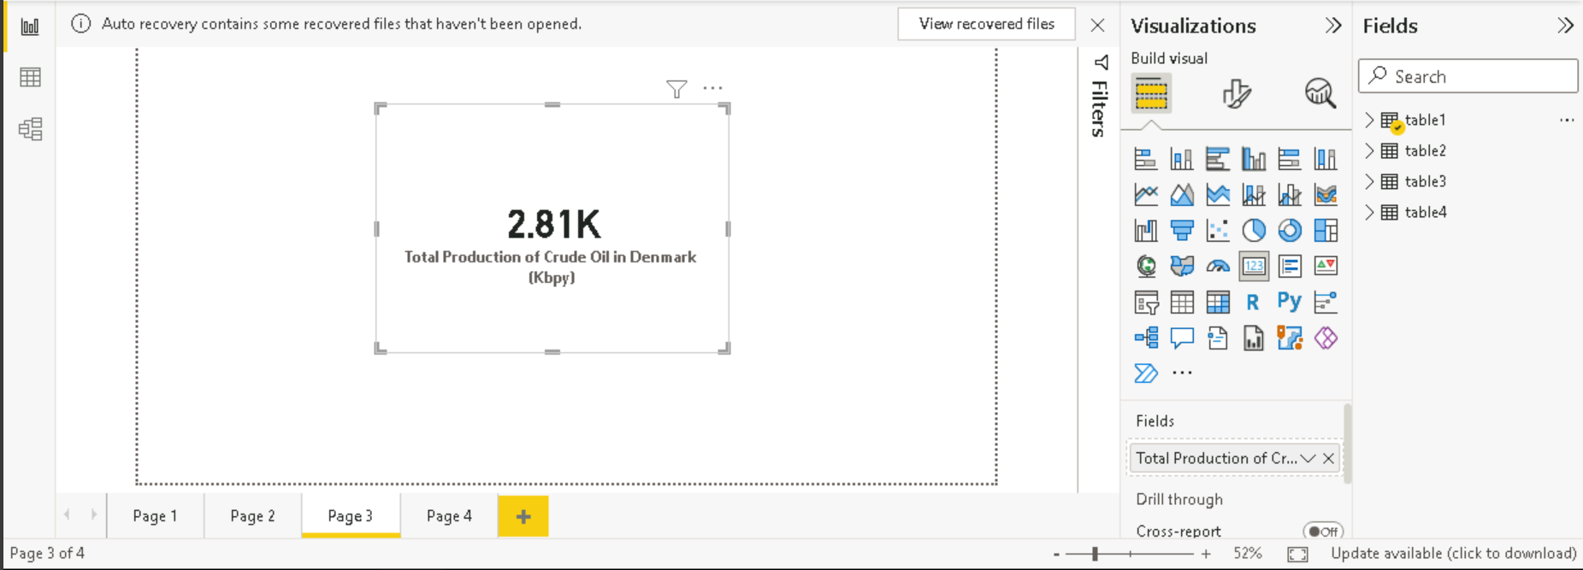
DASHBOARDS BUILT ON POWER BI
Q1) How much crude oil will be produced in Denmark?

Slide 10
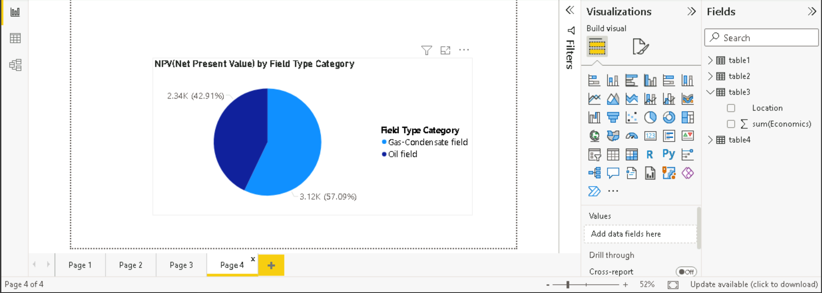
DASHBOARDS BUILT ON POWER BI
Q2) Which are the most valuable fields in Denmark's portfolio?

Slide 11
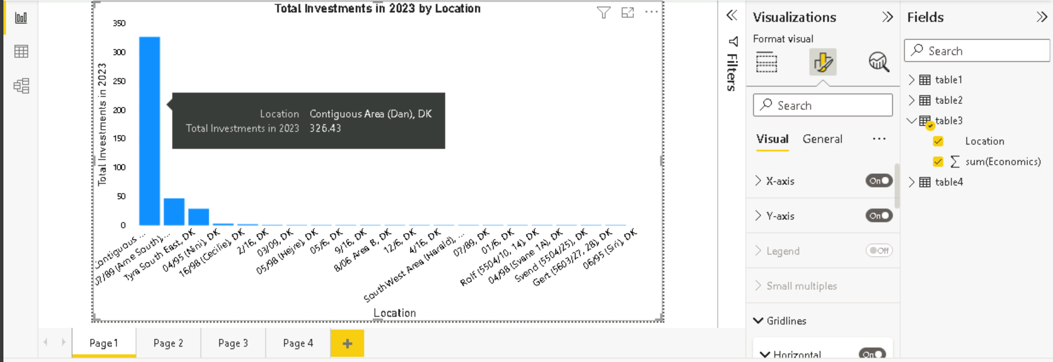
DASHBOARDS BUILT ON POWER BI
Q3) Which Locations will see the largest investments in oil and gas in 2023?

Slide 12
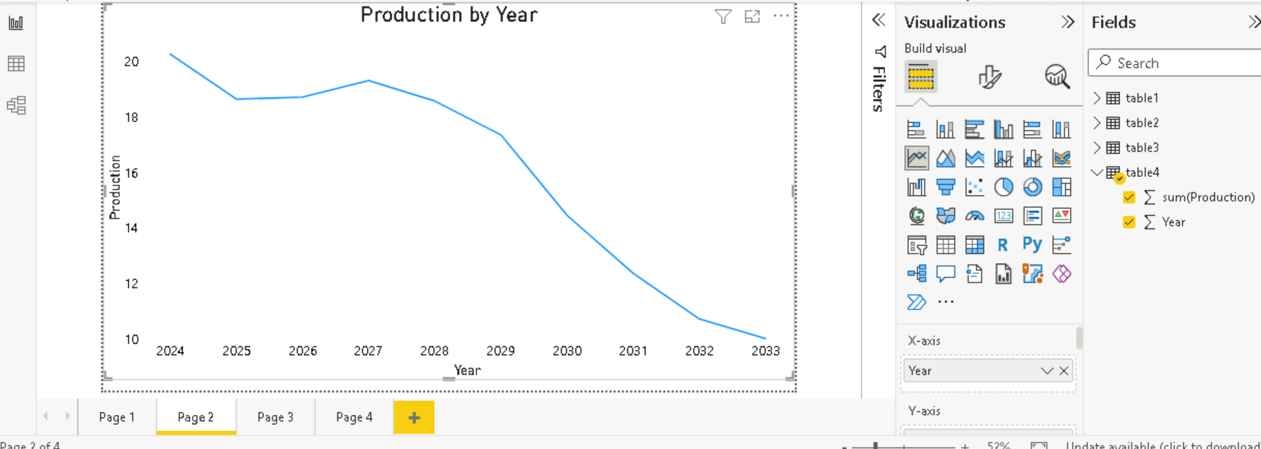
DASHBOARDS BUILT ON POWER BI
Q4) What is the production of crude oil in Denmark over the next decade?

Slide 13
Github Link for code
Atul236/case_study4 (github.com)

Slide 14
Challenges and Learnings
Challenges
1)Lots of datasets to handle
2)Data contained numbers in scientific notation
3)Understanding the data was tough
4)Handling all the null values
Learnings
1)Implemented different aggregation functions to answer the questions.
2)Cleaned large dataset with multiple null values and converted numbers in scientific notation to decimal
3)Implemented connection between azure blob storage, databricks and powerbi in azure datafactory
4)Visualized information in power bi using different charts
5)Used multiple spark functions to clean and transform the data
6)Collaborated with team members to deliver the project within the stipulated time.

Slide 15
THANK YOU

